Slide 1

Flight Price Prediction
24-05-2022
Internship-24
Presented by: Ram kumar

Slide 2
Acknowledgement
Data Science with ML
SME -Khushboo Garg
Flip Robo Technology

Slide 3
What is Flight Price Prediction?
Anyone who has booked a flight ticket knows how unexpectedly the prices vary. The cheapest available ticket on a given flight gets more and less expensive over time. This usually happens as an attempt to maximize revenue based on –
1. Time of purchase patterns (making sure last-minute purchases are expensive)
2. Keeping the flight as full as they want it (raising prices on a flight which is filling up in order to reduce sales and hold back inventory for those expensive last-minute expensive purchases)
So, you have to work on a project where you collect data of flight fares with other features and work to make a model to predict fares of flights.
.

Slide 4
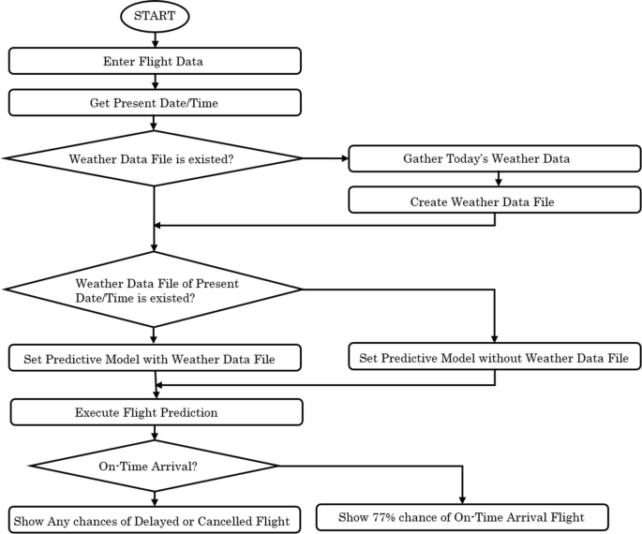
Flight Price Prediction Diagram:

Slide 5
Analytical Problem in dataset

Slide 6
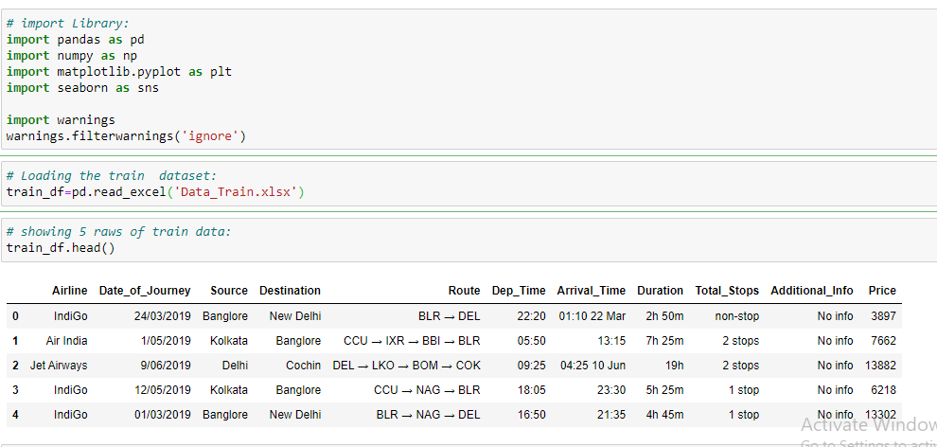
Import library and load the dataset

Slide 7
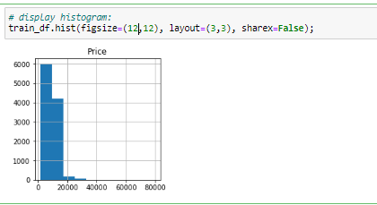
Graphs:
This histplot gives numbers of counts and showing that which is more interesting.
.

Slide 8
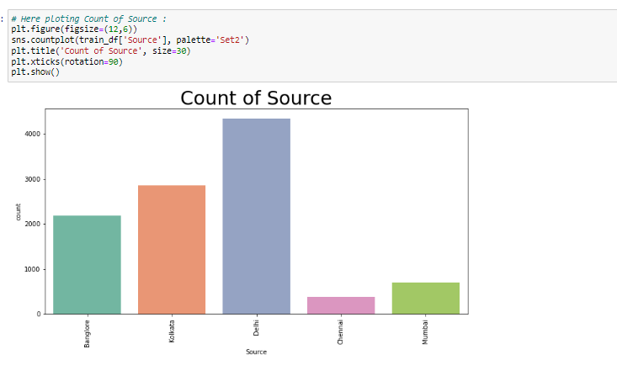
Graphs:
Here Showing countplot values.

Slide 9
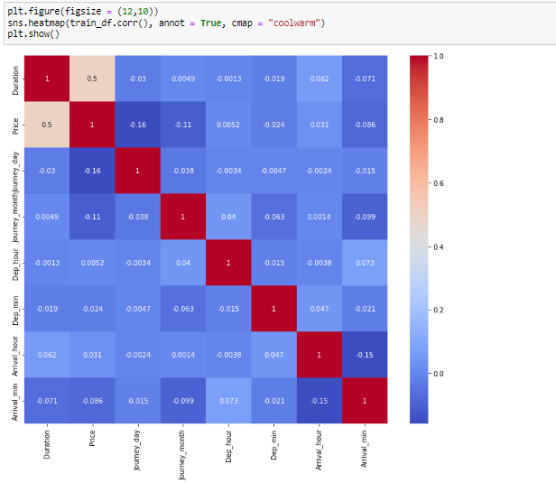
Correlation:

Slide 10
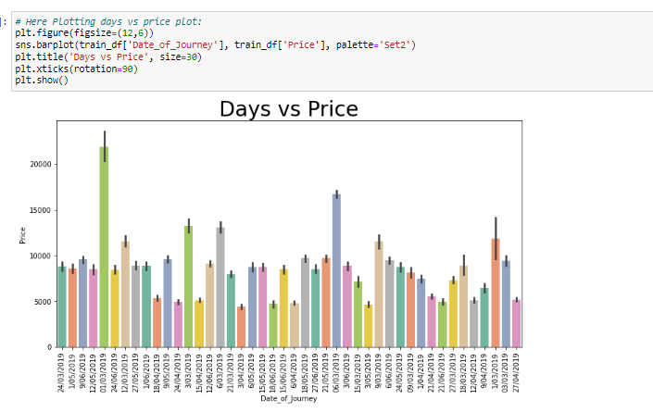
Graphs:

Slide 11
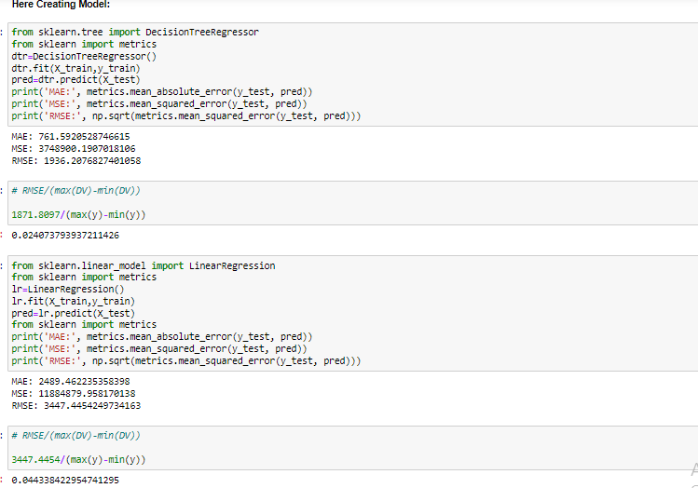
Model/s Development and Evaluation

Slide 12
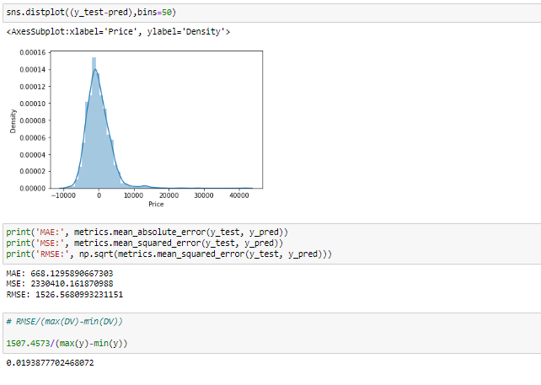
Testing of Identified Approaches (Algorithms):
.

Slide 13
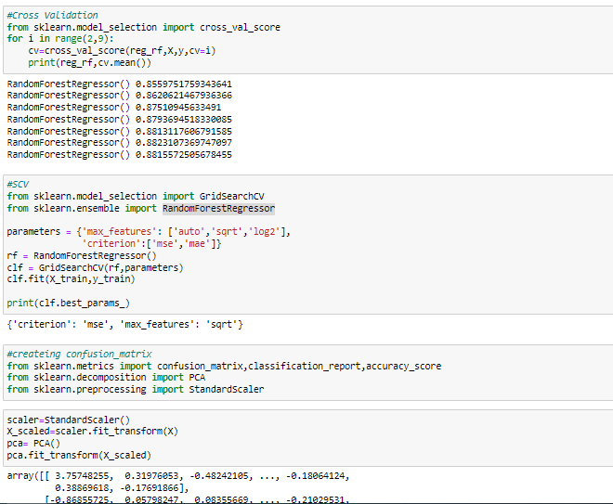
diagram of Evaluate selected models

Slide 14
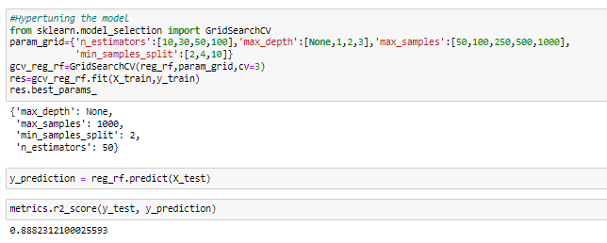
HYPERTUNING THE MODEL:

Slide 15
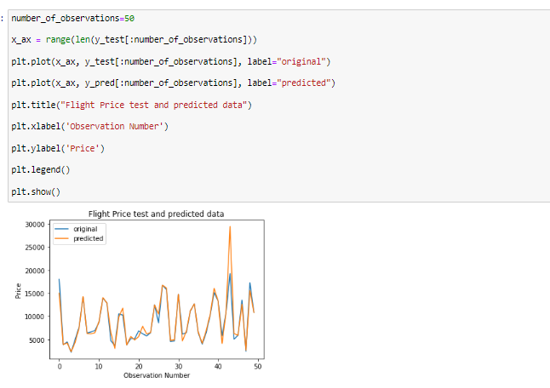
Flight Price test and predicted data:

Slide 16
CONCLUSION :
the machine learning models in the computational intelligence feild that are evaluated before on different datasets are studied. their accuracy and performances are evaluated and compared in order to get better result. For the prediction of the ticket prices perfectly differnt prediction models are tested for the better prediction accuracy. As the pricing models of the company are developed in order to maximize the revenue management. So to get result with maximum accuracy regression analysis is used. From the studies , the feature that influences the prices of the ticket are to be considered. In future the details about number of availble seats can improve the performance of the model.

